Slide 1
Установка github for Windows
https://desktop.github.com/
https://github.com/Tol-v/Web-Programming-lessons

Slide 2
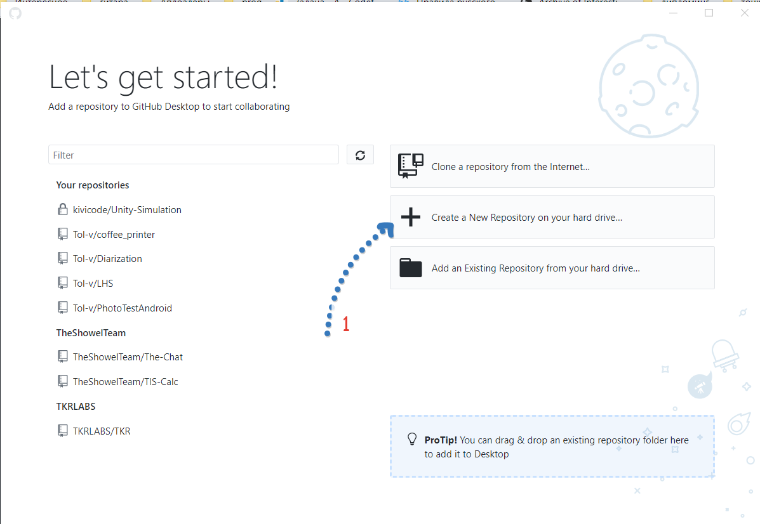

Slide 3
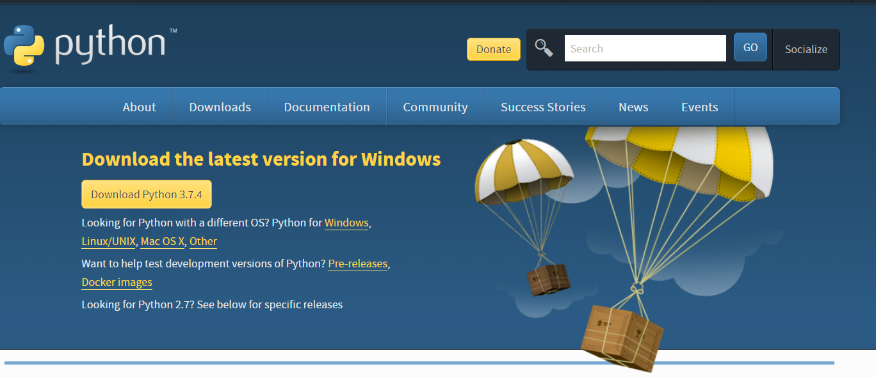
Установка python 3
https://www.python.org/downloads/

Slide 4
__init.py__
from flask import Flask
app = Flask(__name__)
from app import routes

Slide 5
Структура
microblog/
venv/
app/
__init__.py
routes.py
microblog.py

Slide 6
..\Занятие 2\microblog> $env:flask_app = ".\microblog.py"
..\Занятие 2\microblog> py -m flask run
* Serving Flask app "microblog"
* Running on http://127.0.0.1:5000/ (Press CTRL+C to quit)

